Slide 1


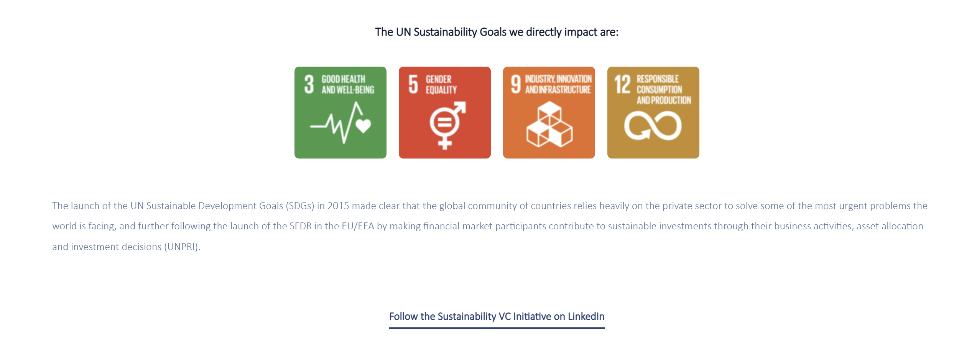
TURNING SCIENCE INTO REAL-WORLD IMPACT
At Hadean Ventures, impact starts with the science. We invest in companies developing products with the potential to address unmet medical needs — and support them with capital, deep sector expertise, strong networks and active ownership.
Our role goes beyond funding. We work closely with management teams to help translate research into clinical and commercial progress, with the aim of supporting better outcomes for patients and society.
HOW WE CREATE IMPACT
+
Sci
ESG
Unmet medical needs
We back companies developing new therapies, diagnostics and technologies for areas of significant unmet medical need, contributing to better health and wellbeing.
Scientific and technical depth
We participate in boards and apply specialist expertise and strong networks to support research, development and innovation.
Responsible investing
We integrate ESG throughout our investment process and portfolio support, with a focus on environmental awareness, gender equality and inclusion, and good governance.
RECENT SUCCESS STORIES: From breakthrough science to tangible outcomes.
RARE DISEASE THERAPEUTICS
PRECISION CANCER MONITORING
Abliva
Abliva is a strong example of how specialist venture capital can help advance Nordic science toward global impact. Hadean backed the company from 2020 and supported its development through active board work, helping drive strategic progress, regulatory milestones and clinical momentum in primary mitochondrial disease.
Abliva's lead asset, KL1333, is being developed for patients with mitochondrial DNA-driven primary mitochondrial diseases, where treatment options remain limited. Following positive clinical progress, Pharming completed its acquisition of Abliva in 2025.
Saga Diagnostics
Saga Diagnostics demonstrates the impact potential of precision diagnostics. The company has developed Pathlight™, a tumor-informed molecular residual disease platform designed to detect and monitor cancer recurrence with high sensitivity.
Roche / Foundation Medicine has announced an agreement to acquire Saga Diagnostics, with Pathlight expected to strengthen Foundation Medicine's monitoring portfolio and support treatment response and recurrence monitoring.
conribute to

